Slide 1
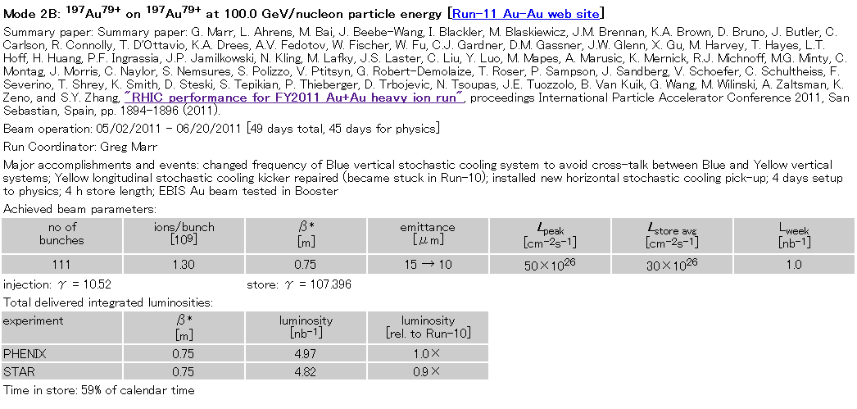
expected beam spot size
obtained parameters from CAD’s web page:
http://www.rhichome.bnl.gov/RHIC/Runs/
definition of emittance
ε = (βγ) * (6σ^2)/β*
(βγ) : relativistic factors
σ : RMS beam size
β* : amplitude function
ε :95% normalized emittance
RUN11 AuAu 200GeV
RUN12 pp 200GeV
β* = 0.75 m (PHENIX)
β* = 0.85 m (PHENIX)
$σ^{lumi}=\frac{σ^{beam}}{\sqrt{2}}=\sqrt{\frac{ϵβ^{∗}}{2∗6γ}}$= 76 μm (ε =10 μm)
= 93 μm (ε =15 μm)
$σ^{lumi}=\frac{σ^{beam}}{\sqrt{2}}=\sqrt{\frac{ϵβ^{∗}}{2∗6γ}}$= 115 μm (ε =20 μm)
= 129 μm (ε =25 μm)
Average 122um
ASANO 2012/07/17
will check vernier scan result

Slide 2
expected beam spot size
RUN11AuAu 200 GeV (use ε(rms)=2.1)
ε(rms)=2.5→1.7um,β*=0.75m,γ=107.4, σ=86μm
RUN12 pp 200 GeV(use ε(rms)=4.0)
ε(rms)=3.3→4.2um,β*=0.85m,γ=106.8,σ=126μm
RUN12 pp 510 GeV(use ε(rms)=4.0)
ε(rms)=3.5→4.2um,β*=0.65m,γ=271.6,σ=69μm
RUN12 UU 193GeV(use ε(rms)=1.0)
ε(rms)=2.2→0.4um,β*=0.70m,γ=103.5,σ=58μm
RUN12 CuAu 200GeV(use ε(rms)=1.5)
ε(rms)=4.1→1.2um,β*=0.70m,γ=107.4, σ=70μm
RUN13 pp 510 GeV(use ε(rms)=3.7)
ε(rms)=3.1→3.9um,β*=0.65m,γ=271.6, σ=67μm
RUN14 AuAu 15 GeV(use ε(rms)=1.7)
ε(rms)=1.7→1.7um,β*=3.5m,γ=7.84, σ=616μm
RUN14 AuAu 200GeV(use ε(rms)=0.8,β*=0.5m)
ε(rms)=2.5→0.65um,β*=0.7m→0.5m,γ=107.4,σ=43μm
RUN14 He3Au 200GeV(use ε(rms)=3um,β*=1m)
ε(rms)=2→3um(He3),β*=1m,γ=107.4,σ=116μm
ε(rms)=2→1.5um(Au)
definition of emittance
ε = (βγ) * (6σ^2)/β*
(βγ) : relativistic factors
σ : RMS beam size
β* : amplitude function
ε :95% normalized emittance
$$σ^{lumi}=\frac{σ^{beam}}{\sqrt{2}}=\sqrt{\frac{ϵβ^{∗}}{2∗6γ}}$$
Rms emittance is sqrt(1/6) of 95% emittance. In terms of RMS emittance
$$σ^{lumi}=\frac{σ^{beam}}{\sqrt{2}}=\sqrt{\frac{ϵ({rms)β}^{∗}}{2∗γ}}$$

Slide 3
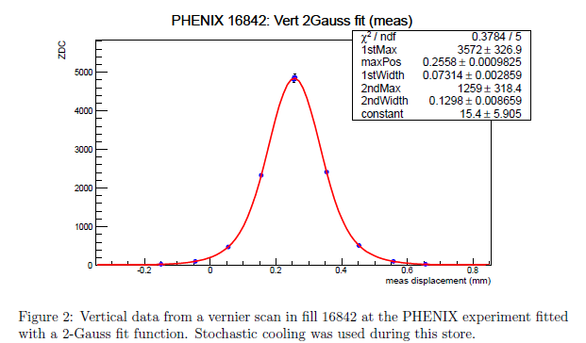
Vernier scan U+U(Angelikca)
epsilon | beta* | gamma | sigma(um)
2.2 | 0.7 | 103.5 | 86.3
0.4 | 0.7 | 103.5 | 36.8
From Fig2 of UU96xsec.pdf by Angelika. Stochastic cooling is.
V-scan profile: σ=73micron
RUN12 UU 193GeV
ε(rms)=2.2→0.4um,β*=0.70m,γ=103.5
If I use ε(rms)=0.4um, it is 36.8 micron. This agrees with 73.14/2=36.6

Slide 4
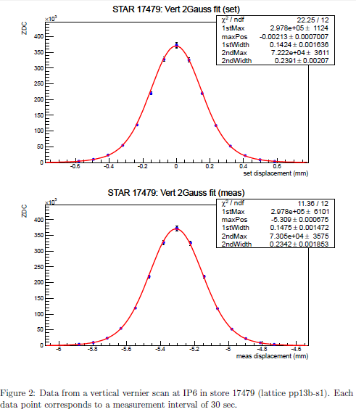
Vernier scan (Angelikca)(2)
This is from RUN13pp 510GeV.
RUN13 pp 510 GeV (use ε(rms)=4.0)
ε(rms)=3.5→4.2um, β*=0.65m,γ=271.6,σ=69μm
Measured profile is sigma=142 μm. The lumi sigma should be half of it → 71 μm, in good agreement with calculation (69 micron). If I use ε(rms)=4.2um, I get σ=70.9μm, exact agreement with 71 micron measured.

Slide 5
Just to check the relation between V-scan sigma and lumi sigma.
Collision rate with beam separation Δ
$\int{dxdy exp⁡(−\frac{x^{2}+y^{2}+(x−∆)^{2}+y^{2} }{2σ^{2}}}$)
$$∝\int{dx}exp⁡(−\frac{x^{2}+ (x−∆)^{2}}{2σ^{2}})$$
$$∝\int{dx}exp⁡(−\frac{{2x}^{2}−2x∆+∆^{2}}{2σ^{2}})$$
$$∝\int{dx}exp⁡(−\frac{{2(x−∆/2)}^{2}+∆^{2}/2}{2σ^{2}})$$
$$∝exp⁡(−\frac{∆^{2}/2}{2σ^{2}})$$
The rms width of the collision rate as a function of Δ, i.e. σ($∆$), is sqrt(2) of actual beam size.
When Δ=0, the rms width of th espatial distribution of luminosity, i.e. , σ（Lumi) is 1/sqrt(2) of the beam width.
Thus σ($∆$)＝2 σ（Lumi). V-scan measures σ($∆).$ The luminosity spot size σ（Lumi) is ½ of σ($∆).$

